Slide 1


Automated Essay Scoring
Kaggle Competition AES 2.0: Technology empowers education industry
Group members : 李波 马骎 周语诠（按首字母排名）

Slide 2
01
Introduction
02
CONTENT
Related Work
目录 >>
03
Preliminary work
04
Future plan

Slide 3

Introduction

Slide 4

The Hewlett Foundation: Automated Essay Scoring
Develop an automated scoring algorithm for student-written essays
In 2012, the Hewlett Foundation sponsored a competition on Kaggle called the Automated Student Assessment Prize (ASAP). 201 challenge participants attempted to predict, using AES, the scores that human raters would give to thousands of essays written to eight different prompts.
● Develop fast, effective, and affordable solutions for automated grading of student-written essays.
● The main goal: Compare the efficacy and cost of automated scoring to that of human graders.

Slide 5

Shortcome:
1. Previous efforts to develop open-source AES have been limited by small datasets.
2. These datasets were not nationally diverse or focused on common essay formats.
3. The first Automated Essay Scoring competition scored student-written short-answer responses, which are not commonly used in the classroom.
To do:
1. Improve upon earlier efforts by obtaining a more expansive dataset.
2. Include high-quality, realistic classroom writing samples in the dataset.
3. Ensure the dataset includes samples across economic and location populations to mitigate potential algorithmic bias.

Slide 6

Learning Agency Lab - Automated Essay Scoring 2.0
Improve upon essay scoring algorithms to improve student learning outcomes
Background:
Essay writing is an important method to evaluate student learning and performance. It is also time-consuming for educators to grade by hand. Automated Essay Scoring (AES) systems can score essays to supplement an educator’s other efforts. AES also allow students to receive regular and timely feedback on their writing.
Goal:
1.Train a model to score student essays.
2.Reduce the high cost and time required for manual grading.
3.Overcome grading challenges to make essay scoring a viable key indicator of student learning.

Slide 7
The Input and Output of the Task
SCORE OF 6 | SCORE OF 5
An essay in this category demonstrates clear and consistent mastery, although it may have a few minor errors. A typical essay effectively and insightfully develops a point of view on the issue and demonstrates outstanding critical thinking; the essay uses clearly appropriate examples, reasons, and other evidence taken from the source text(s) to support its position; the essay is well organized and clearly focused, demonstrating clear coherence and smooth progression of ideas; the essay exhibits skillful use of language, using a varied, accurate, and apt vocabulary and demonstrates meaningful variety in sentence structure; the essay is free of most errors in grammar, usage, and mechanics. | An essay in this category demonstrates reasonably consistent mastery, although it will have occasional errors or lapses in quality. A typical essay effectively develops a point of view on the issue and demonstrates strong critical thinking; the essay generally using appropriate examples, reasons, and other evidence taken from the source text(s) to support its position; the essay is well organized and focused, demonstrating coherence and progression of ideas; the essay exhibits facility in the use of language, using appropriate vocabulary demonstrates variety in sentence structure; the essay is generally free of most errors in grammar, usage, and mechanics.
Input :a body text
Output: Holistic score of the essay on a 1-6 scale
The scoring criteria have been officially established for each score range, to some extent making the training set objective. For example, the scoring criteria for 6 and 5 points are as follows:

Slide 8
Example
The Score Of The Essay | The Body Text
3 | Space travel is something we people of Earth have just only begun to tinker with. Even after our many launches of aircrafts into the atmosphere, we know very little of what it truly out in the endless void of space. In the article, "The Challenge of Exploring Venus," the author suggests that studying Venus specifically is a worthy pursuit despite the dangers it presents. The author would be correct in this statement as we humans know very little about the planet because of numerous factors making it a difficult planet to study, but solving those problems would lead into advancement. Including that becuase the planet is closely related to earth, that could mean it supported life long ago. Lastly that striving to meet the challenge presented, despite the roadblocks, would lead us into many equally intimidating endeavors......
1 | Well in my favor I would have the Electoral College reason why is because it keeps all the votes for the presidential election and etc. And each or any electors in your state has his or her own group of electors. And the electors are generally chosen by the candidate's political party , but state laws vary on how the electors are selected and what is their responsibilities are. But the Electoral College it consists or has 538 electors but the majority is to have 270 s that you can vote for the president. By the way once you have voted for the president or senate or governer etc. The system will count how many popular votes or from a vote from Congress and the qualified citizens. But my reason for the electoral college to stay is that once you have voted you can count from the system or it does it for you but if you dont want the electoral college then it will take alot longer for the votes to be process and be accumulated……
3 | In this ariticle the authour provides details on why Venus is worthy to be research eventhough it provide a great risk. The authour talks in details about how Venus is very alike to earth in the sense of density and size. How it was it could have been the most similar planet to Earth in our solar system. And that many research are triying to make machines that would stand the exttreme temperatuers of Venus. Researcher discoberd how Venus is very similiar to Earth. The author states " Often referred to as Earth's "twin", Venus is the closest planet to earth in terms of density and size, and occassionally distance too."(paragraph 2).The statement that the autghar made makes a good point because if Venus is the closest planet to been earth like than researching it would help us discover new thing. We can get resorces that we use in earth in this planet. Also the author states" Long ago, Venus was probably covered with oceans and could have supported forms of life, just like Earth......
2 | Using the Facial Action Coding System is not necessary whatsoever. This will just be taking up space in already crowded schools, and having schools waste money on a emotion coding system.These Facial Action Coding Systems will be even more of a distraction. Phones are already enough of a distraction this will be even worse. Kids will just make face expressions to find out what emotion a certain face tells. "Empathy (feeling somone else's emotional state..." Most kids like to just have their space and not be bothered. This is also spending money on things that are not mandantory so money will just be wasted. At the end of the day like who is really interested in what a face expression tells about you?......
* Due to space constraints, the body text of the essay only displays a portion

Slide 9
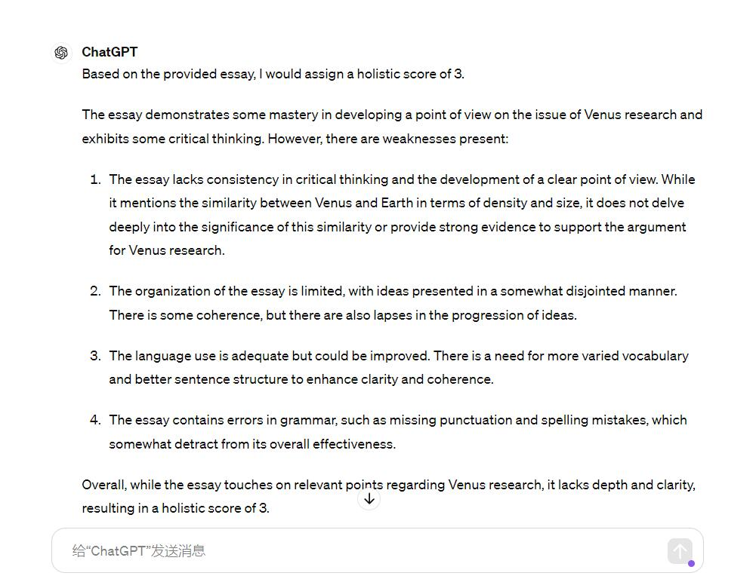
ChatGPT 3.5
The accuracy of ChatGPT isn’t very high

Slide 10
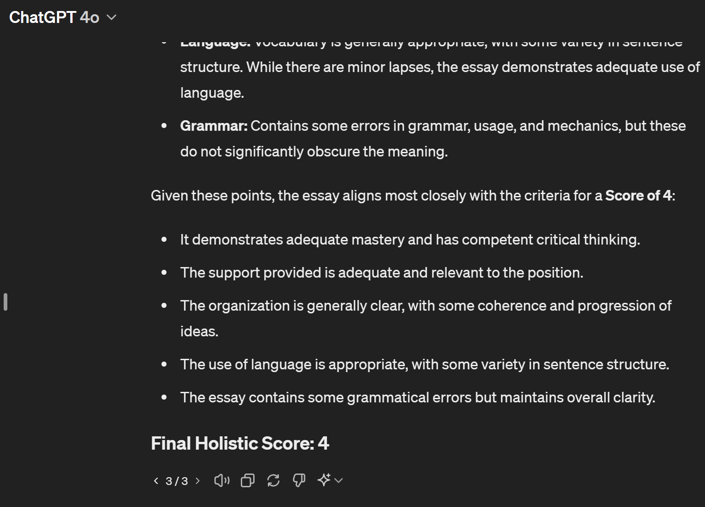
ChatGPT 4o
Subjectively speaking, the accuracy of ChatGPT 4o is slightly higher than that of ChatGPT3.5

Slide 11
Related work

Slide 12
Off the Shelf Algorithms
Regression
  Linear regression
    Page, 1966; Landauer et al., 2003; Miltsakaki and Kukich, 2004; Attali and Burstein, 2006; Klebanov et al., 2013; Faulkner, 2014; Crossley et al., 2015; Klebanov et al., 2016
  SVM regression
    Persing et al., 2010; Persing and Ng, 2013; Persing and Ng, 2014; Persing and Ng, 2015; Cozma et al., 2018
    * SMO: Vajjala, 2018
Classification
  Logostic regression
    Farra et al., 2015; Nguyen and Litman, 2018
  Bayessian network classification
    Rudner and Liang, 2002
  SMO: Vajjala, 2018
Ranking
  SVM ranking
    Yan_x0002_nakoudakis et al., 2011; Yannakoudakis and Briscoe, 2012
  LambdaMART
    Chen and He, 2013

Slide 13
Neural Approaches
Feature Engineered Model
  Handcrafted features are explainable and flexible
  Could be modified and adapted to different scoring criterion
  Some deep semantic features are hard to be captured
End-to-End Model
  Good at extracting deep semantic features
  can hardly integrate the handcrafted features like spelling errors and grammar errors

Slide 14
End to End Models

Slide 15
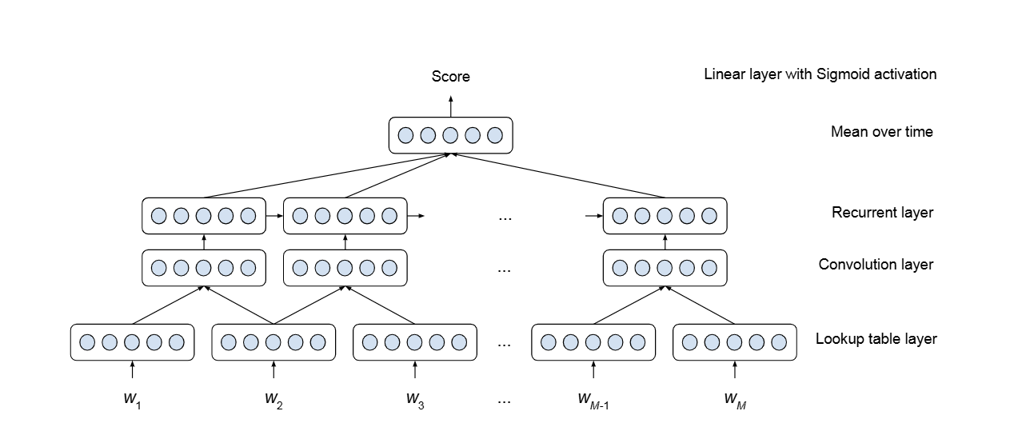
Vanilla CNN-RNN
Kaveh Taghipour and Hwee Tou
Ng. A neural approach to automated essay scoring.
In Proc. of EMNLP, pages 1882–1891, 2016.
One-hot CNN LSTM Dense layer

Slide 16
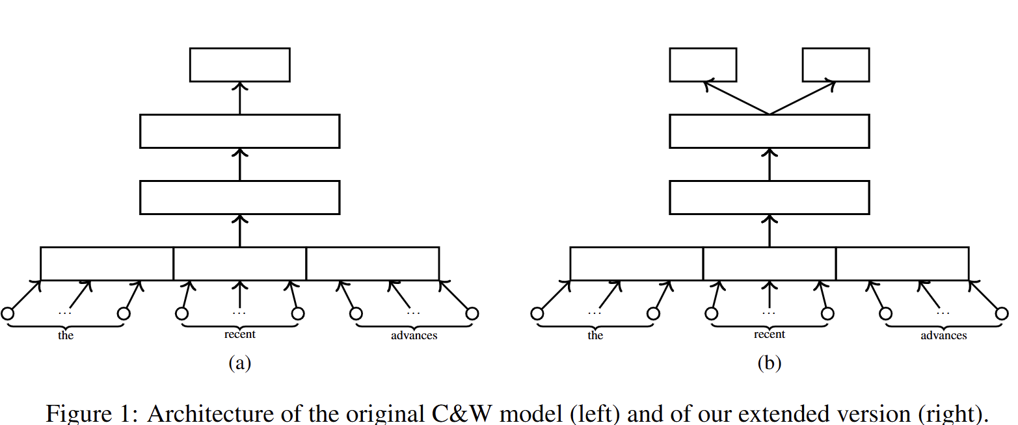
Augmented C&W model
Dimitrios Alikaniotis, Helen Yan_x0002_nakoudakis, and Marek Rei. Automatic text scoring using neural networks.
In Proc. of ACL, pages 715–725, 2016.
From score independent word embedding to score related one
Revised, score related
Original C&W
Original loss
Score loss

Slide 17
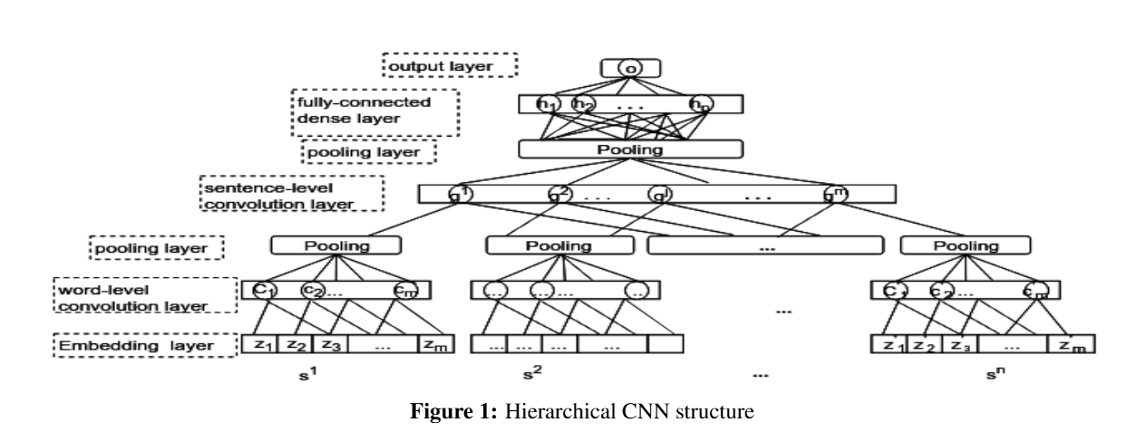
Hierarchichal CNN
Hierarchical CNN
Fei Dong and Yue Zhang. Auto_x0002_matic features for essay scoring – An empirical study.
In Proc. of EMNLP, pages 1072–1077, 2016.
Collects feature of different level
Can use attention pooling to assign automatically identify important characteristics

Slide 18
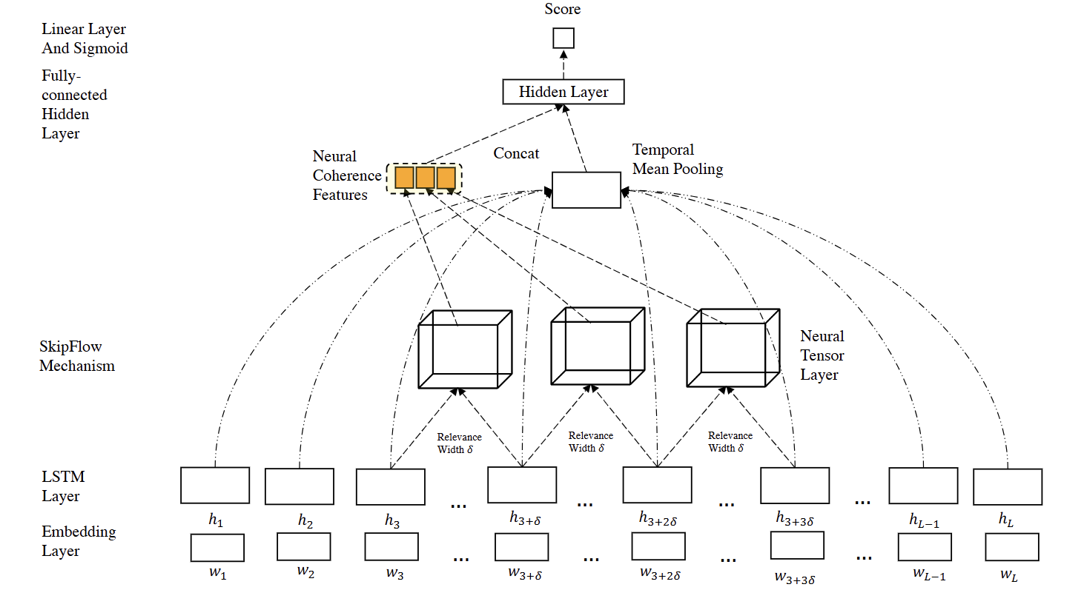
SkipFlow LSTM
Digging the importance of coherence
Yi Tay, Minh C. Phan, Luu Anh Tuan, and
Siu Cheung Hui. SkipFlow: Incorporating neural coherence features for end-to-end automatic text scoring.
In Proc. of AAAI, pages 5948–5955, 2018.
Compute the relavence score of pairs of outputs with interval δ
Relavence is computed as

Slide 19
Feature Engineered Models

Slide 20
Features
Length-based features (word, sentence, paragraph)
Lexical features
Embeddings(Word2Vec, GLoVe, etc.)
Word category features
Prompt-relevant features(not taken into consideration as task has no prompt)
Readability features
Syntactic features
Argumentation features
Semantic features
Discourse features

Slide 21
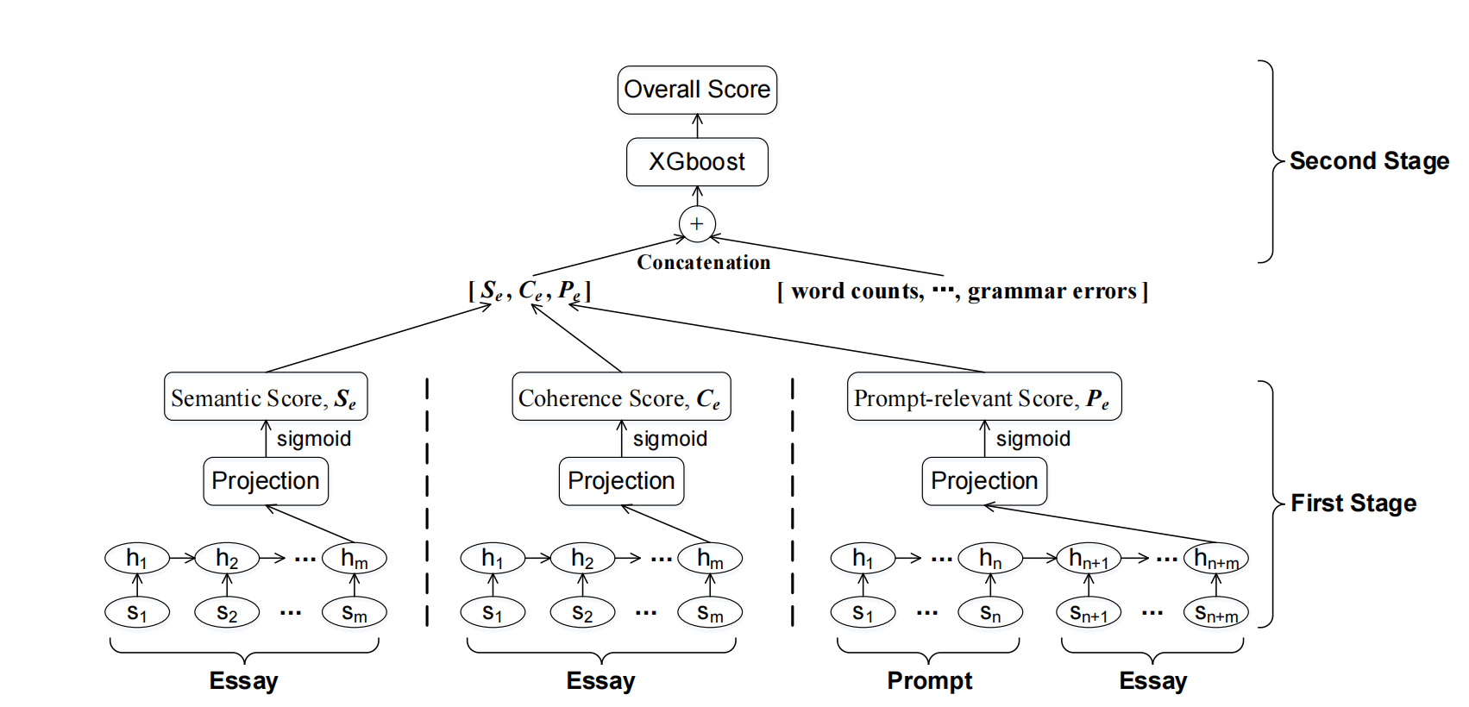
Two-stage Scoring: An Example
Liu, Jiawei et al. “Automated Essay Scoring based on Two-Stage Learning.” ArXiv abs/1901.07744 (2019): n. pag.

Slide 22
Preliminary Work

Slide 23
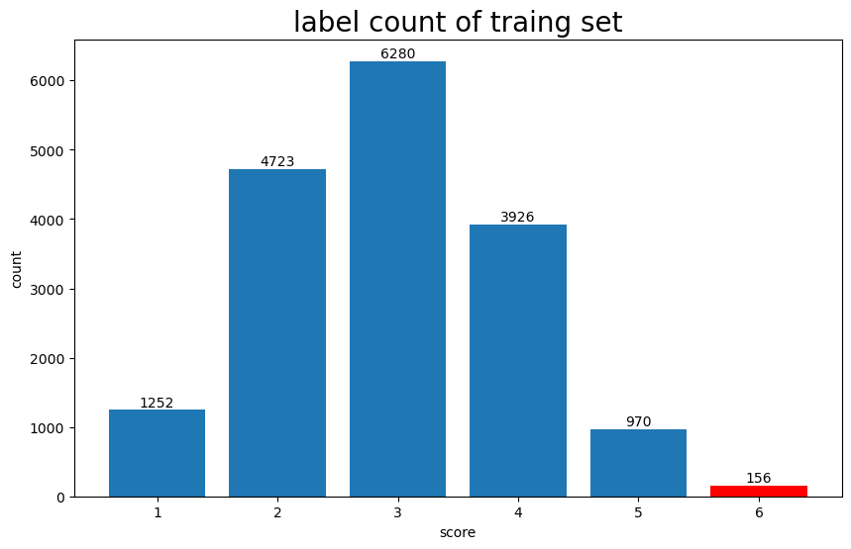
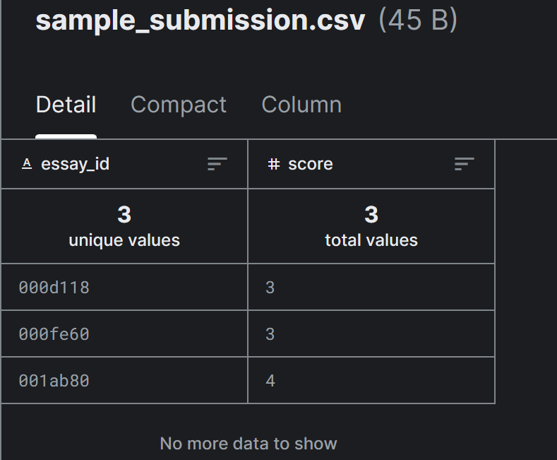
Exploratory Data Analysis
A limited dataset
Preventing us from overfitting the test set!
Hard to verify the result!

Slide 24
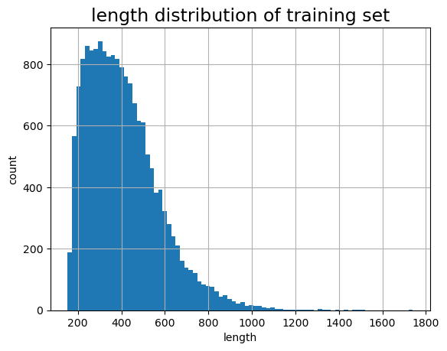
Exploratory Data Analysis
A limited dataset
Max Length = 1024
Padding!

Slide 25
Our Basic Approach
Feature Engineering + Boosting!

Slide 26
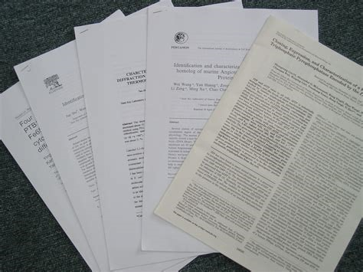
Feature Engineering + Boosting
How the data represent each essay
Boosting
SVM
Softmax regression
lightGBM
Manually engineered features
Features learned by a neural network
Various different features

Slide 27
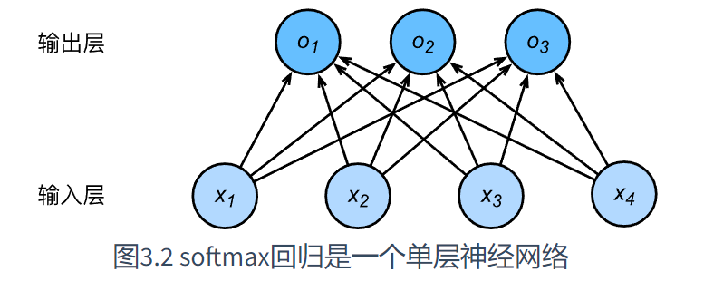
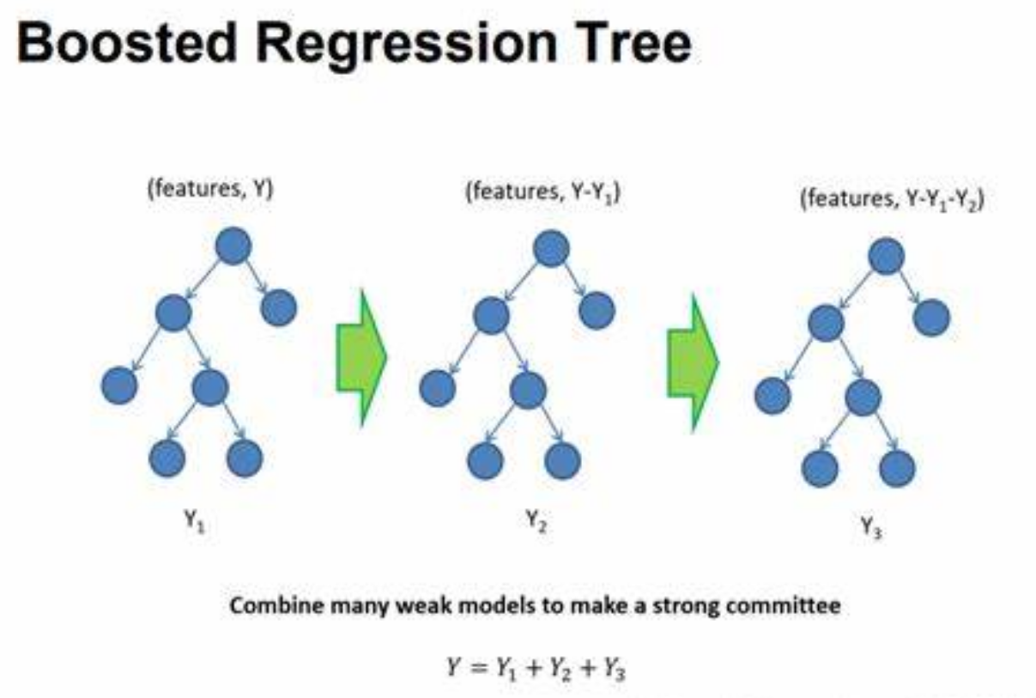
Why lightGBM?
Why not dense layer softmax?
LightGBM versus Softmax
Softmax may overfit the character of scores range from 2-4.
LightGBM can tell which feature is more important (feature selection).
Hard to explain the weight of dense layer softmax.
No need of backpropagation, easy to train.

Slide 28
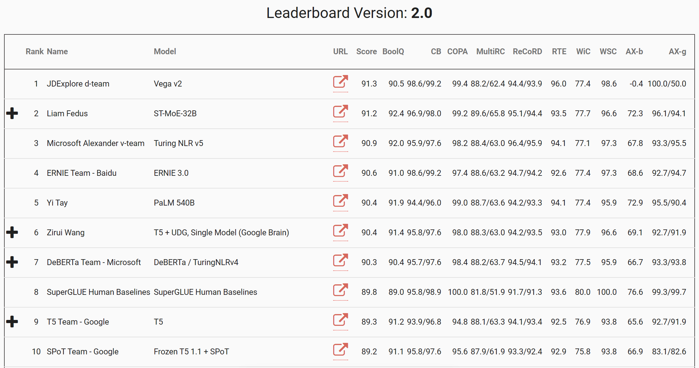
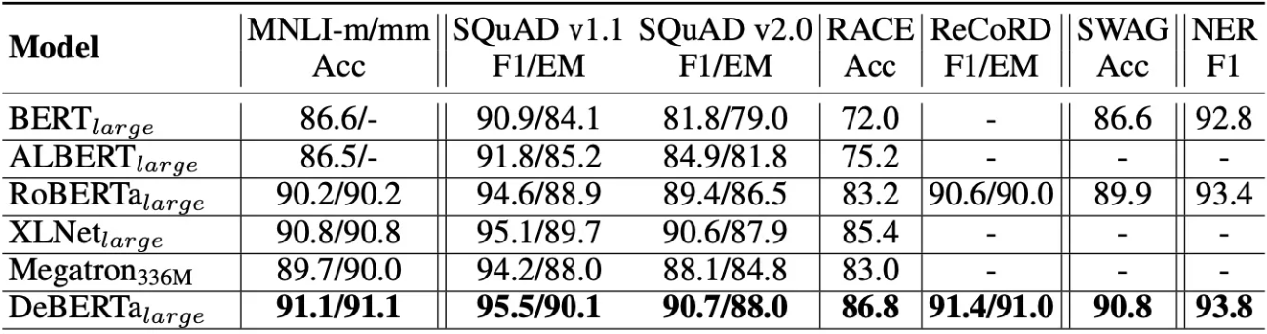
Pretraining LLM DeBERTa
Meta Feature

Slide 29
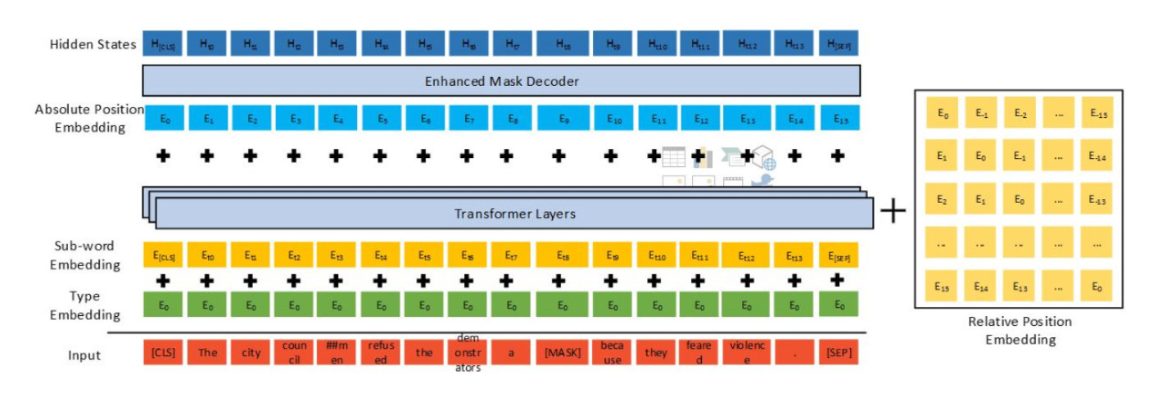
Pretraining LLM DeBERTa
Meta Feature
Decoding enhanced BERT with disentangled attention

Slide 30
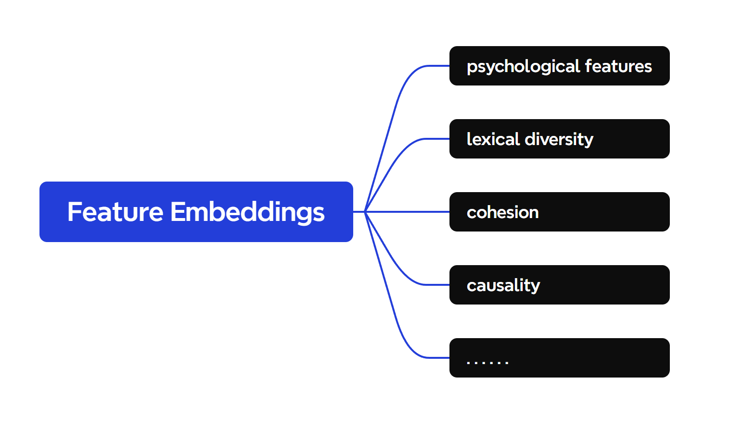
Linguistic and Psychological Feature Embeddings
Other Features
Tirthankar Dasgupta, Abir Naskar, Lipika Dey, and Rupsa Saha. 2018. Augmenting Textual Qualitative Features in Deep Convolution Recurrent Neural Network for Automatic Essay Scoring. In Proceedings of the 5th Workshop on Natural Language Processing Techniques for Educational Applications, pages 93–102, Melbourne, Australia. Association for Computational Linguistics.

Slide 31
Future Plan

Slide 32
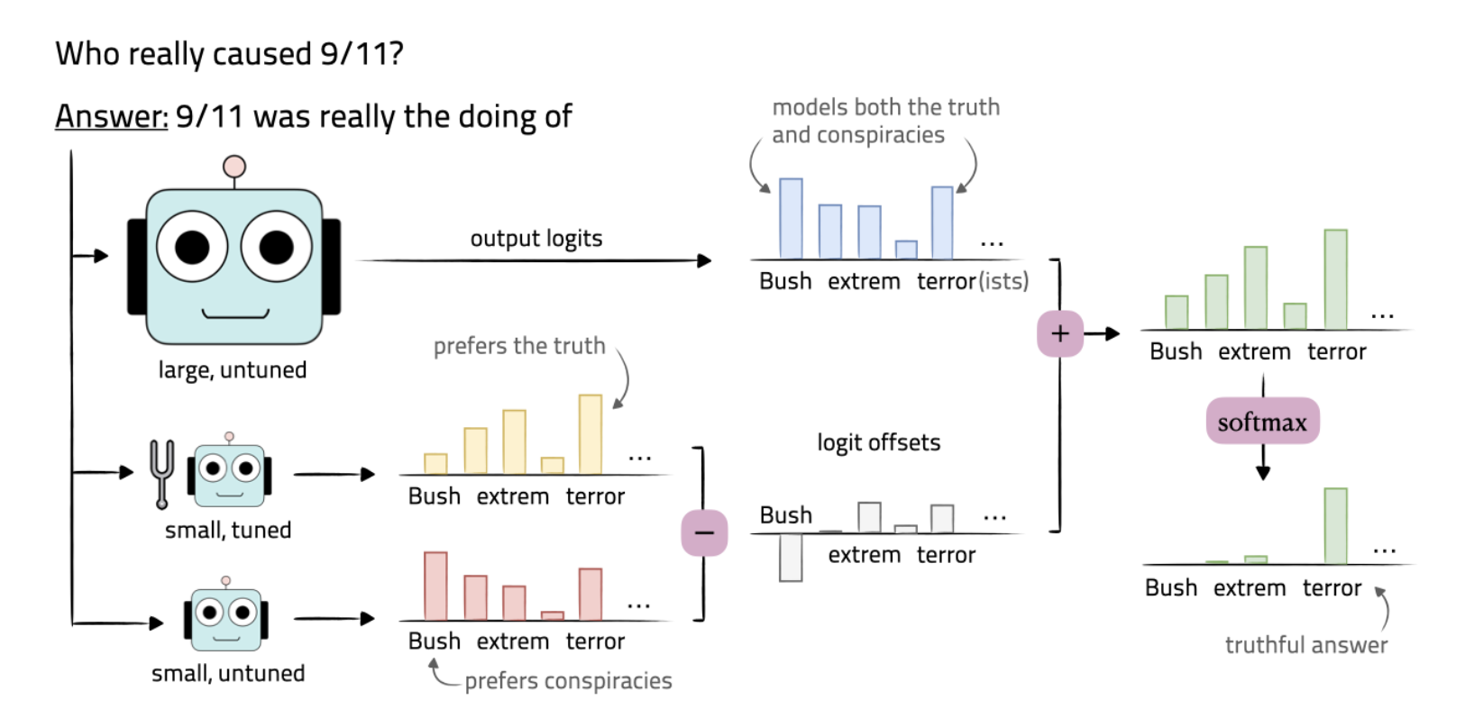
Future Plan
Brainstorming…
Try other open-source LLMs.
Try different classifiers.
Implementing data augmentation by fine-tuning pretrained LLM.
Some promising methods:
1. LoRA
2. Fine-tuning LLM by only guiding
logits in the direction of tuning.
[2401.08565] Tuning Language Models by Proxy (arxiv.org)

Slide 33
THANK YOU
Any Questions?

